Slide 1


Cinema Solutions
Ticket Booking System
Members: Mohib Ahmed (CT 178)
Shayan Ali (CT 198)
Anas Shahid (CT 179)
Course: CCP
Instructors: Sir Abdullah
NED University of Engineering and Technology

Slide 2

Cinema Ticket Booking System
This project is a simple Cinema Ticket Booking System written in the C language. It allows users to view available seats, book tickets, and cancel bookings. The goal is to simulate a basic cinema ticket counter system using loops, conditional statements, and input validation. The program demonstrates structured programming concepts and menu-driven design.

Slide 3
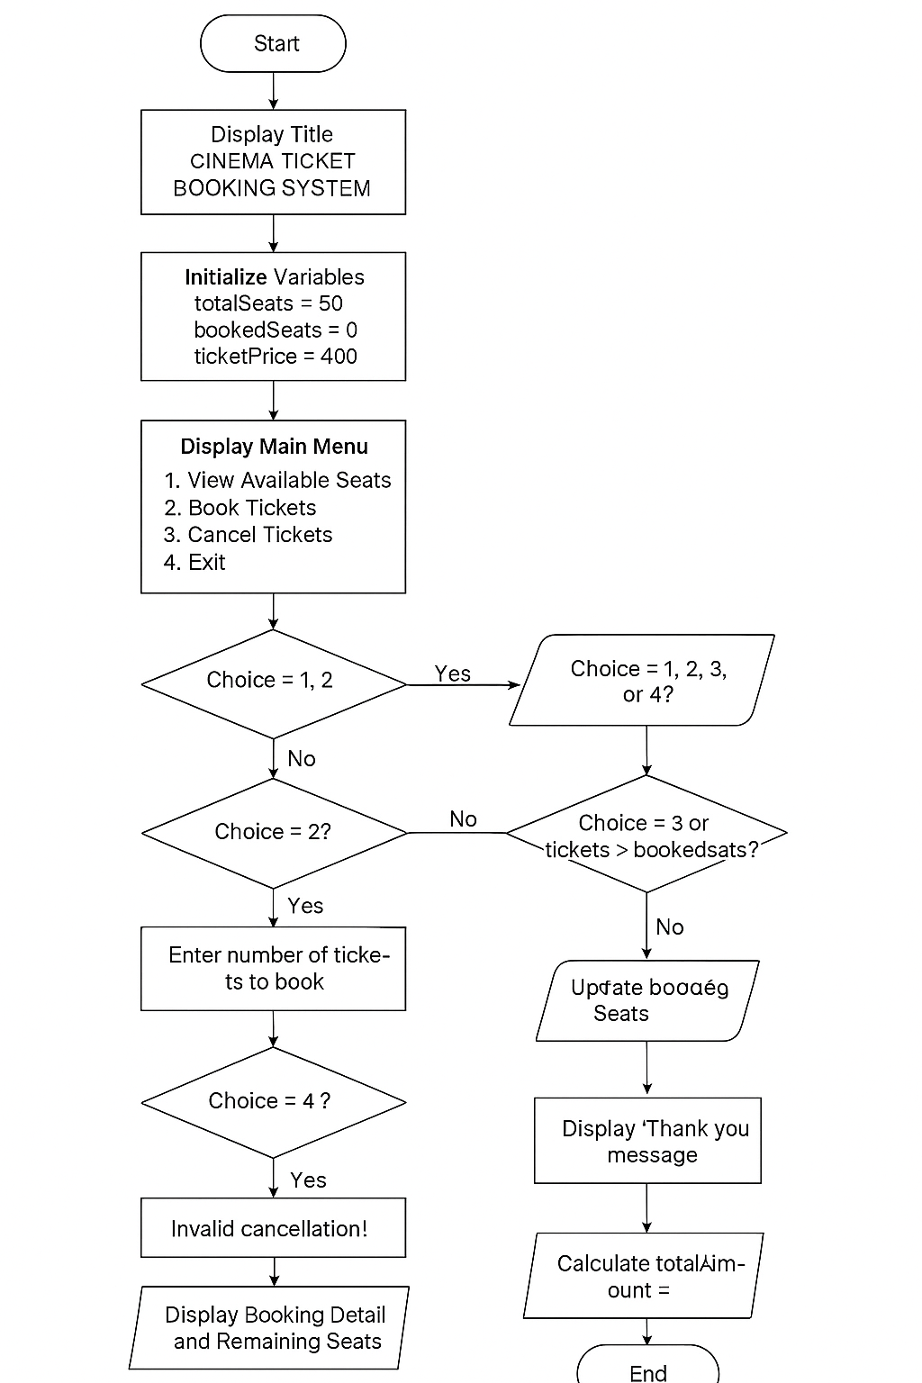

Slide 4

Code Setup
The program includes the standard libraries:
- stdio.h for input and output functions (printf, scanf)
- stdlib.h for system() function to clear the screen
Variables Used:
- totalSeats = 50
- bookedSeats = 0
- ticketPrice = 400
- tickets, totalAmount, choice
These variables help manage seat availability, ticket price, and user menu selections.

Slide 5
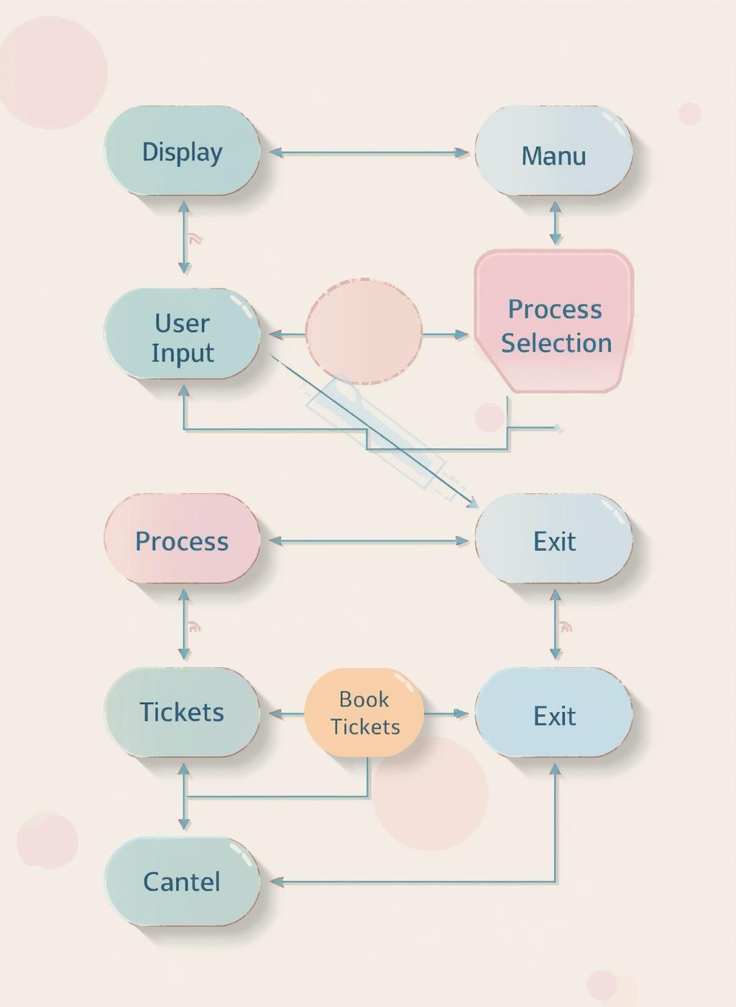
Main Function Flow
The main function controls the program’s flow using a do-while loop. It repeatedly displays a menu with options:
1. View Available Seats
2. Book Tickets
3. Cancel Tickets
4. Exit
The user’s choice is taken as input and processed using a switch-case structure. This approach ensures the program runs continuously until the user chooses to exit.

Slide 6

Ticket Booking Logic
When the user selects option 2, the program asks how many tickets to book.
Validation checks:
- Tickets must be greater than 0.
- Booked tickets + new tickets ≤ total seats.
If valid, bookedSeats is updated and totalAmount = tickets × ticketPrice.
Then the system displays booking details and remaining seats.

Slide 7
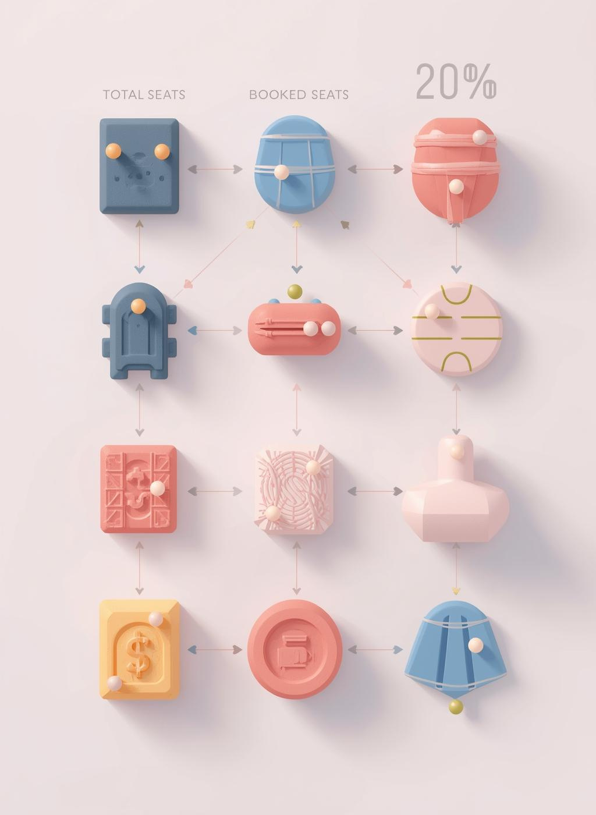
Ticket Cancellation Logic
If the user selects option 3, they can cancel previously booked tickets.
Validation checks:
- Tickets to cancel must be > 0.
- Tickets to cancel ≤ bookedSeats.
After successful cancellation, bookedSeats decreases and the system updates remaining seats.

Slide 8
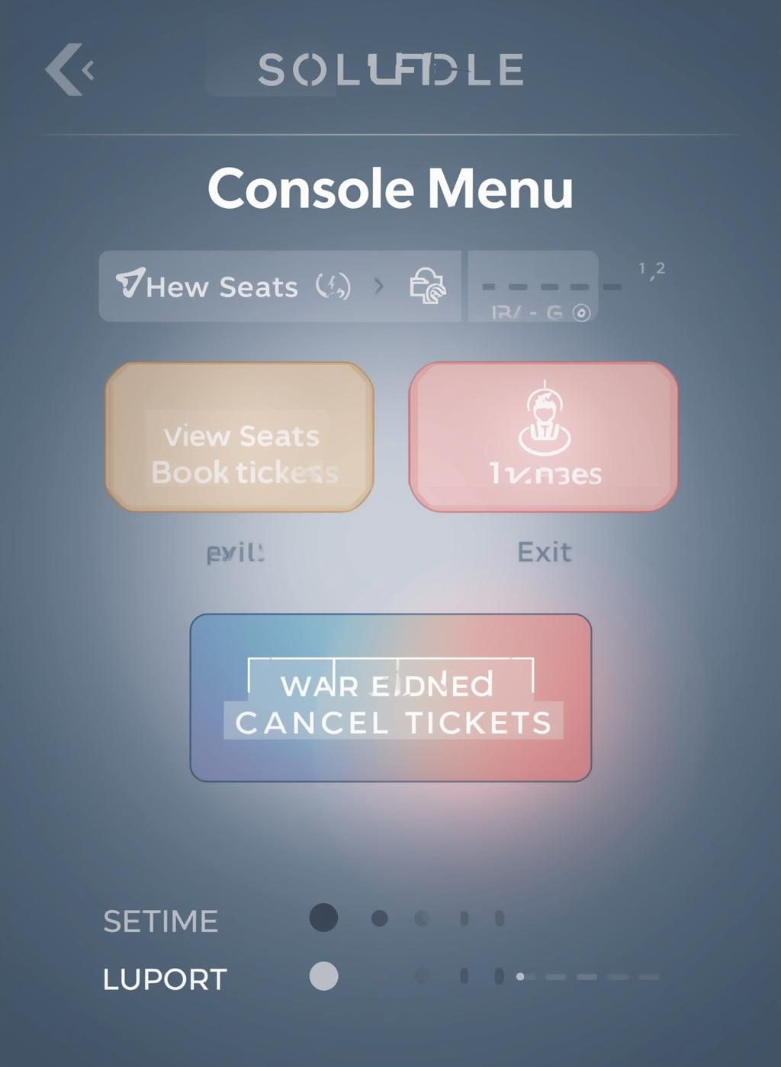
Output Example
=============================
CINEMA TICKET BOOKING SYSTEM
=============================
1. View Available Seats
2. Book Tickets
3. Cancel Tickets
4. Exit
Example:
Booking 3 tickets @ Rs.400 each = Rs.1200
Remaining Seats: 47
Cancellation Example:
Cancelled 2 tickets, Remaining Seats: 49

Slide 9
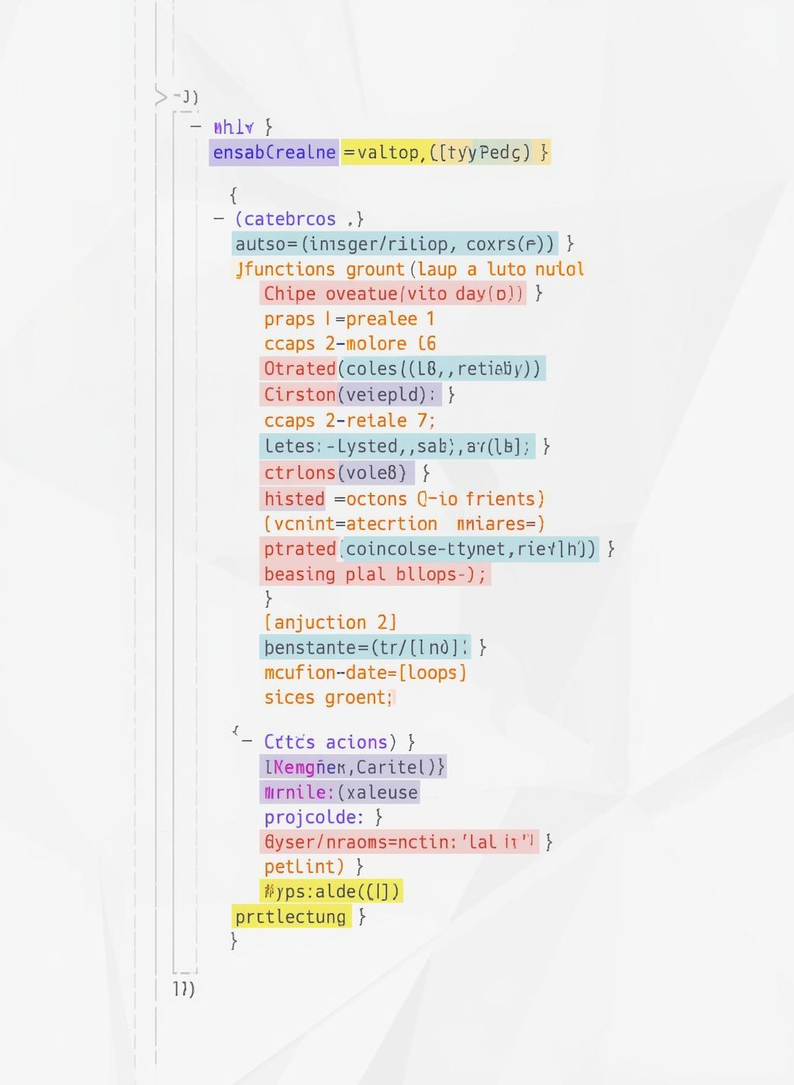
Lessons Learned
- Importance of Input Validation: Preventing incorrect or invalid data.
- Control Structures: Efficient use of loops and switch-case for menu-driven programs.
- Modular Thinking: Handling separate functionalities for booking, canceling, and displaying seats.
- Debugging Skills: Learning to identify and correct logical and runtime errors.
- Practical Understanding: Simulating real-world booking logic with C programming.

Slide 10

Difficulties Faced and Resolutions
1. Input Validation Errors:
Handled invalid or negative ticket inputs using conditional checks.
2. Overbooking Issues:
Added validation to prevent booking more tickets than available seats.
3. Data Loss After Exit:
System currently does not store data after exit (can be fixed using file handling).
4. Display Formatting:
Used system("cls") to clear screen for better console readability.

Slide 11
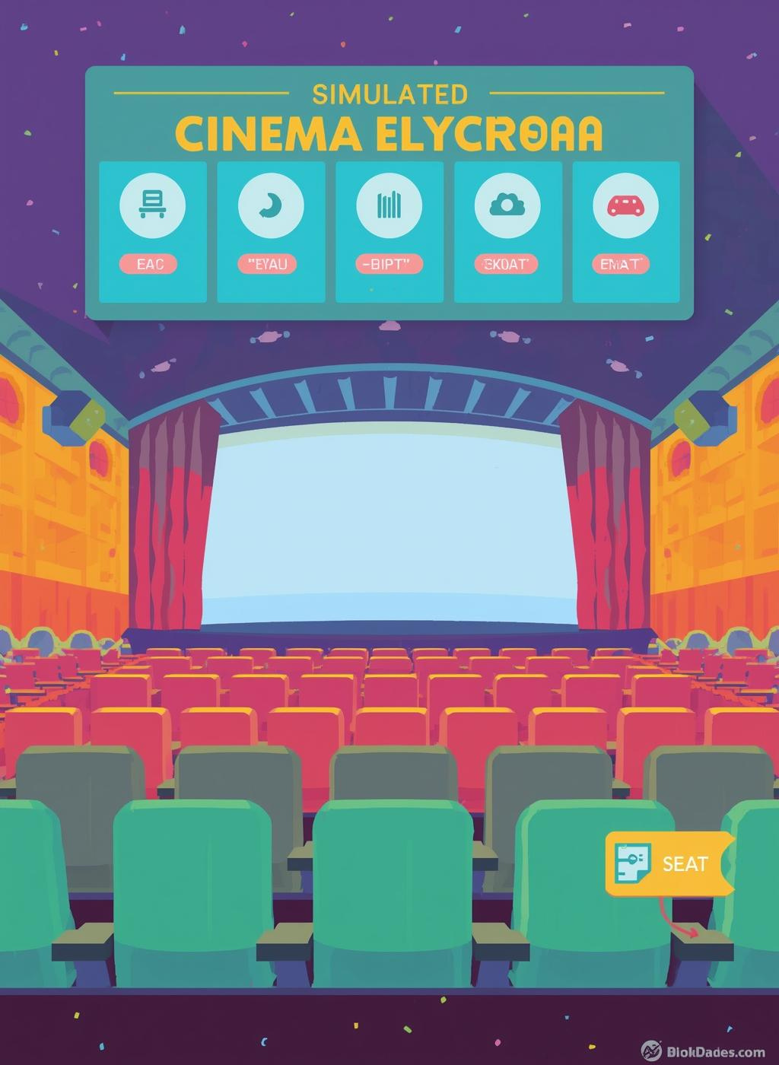
Results
The Cinema Ticket Booking System successfully simulates basic ticket counter operations. It demonstrates C programming fundamentals including loops, conditionals, and user input handling. Future improvements may include seat mapping, file-based data storage, and multiple movie screenings.
This project enhances logical thinking and programming efficiency in procedural languages.

Slide 12
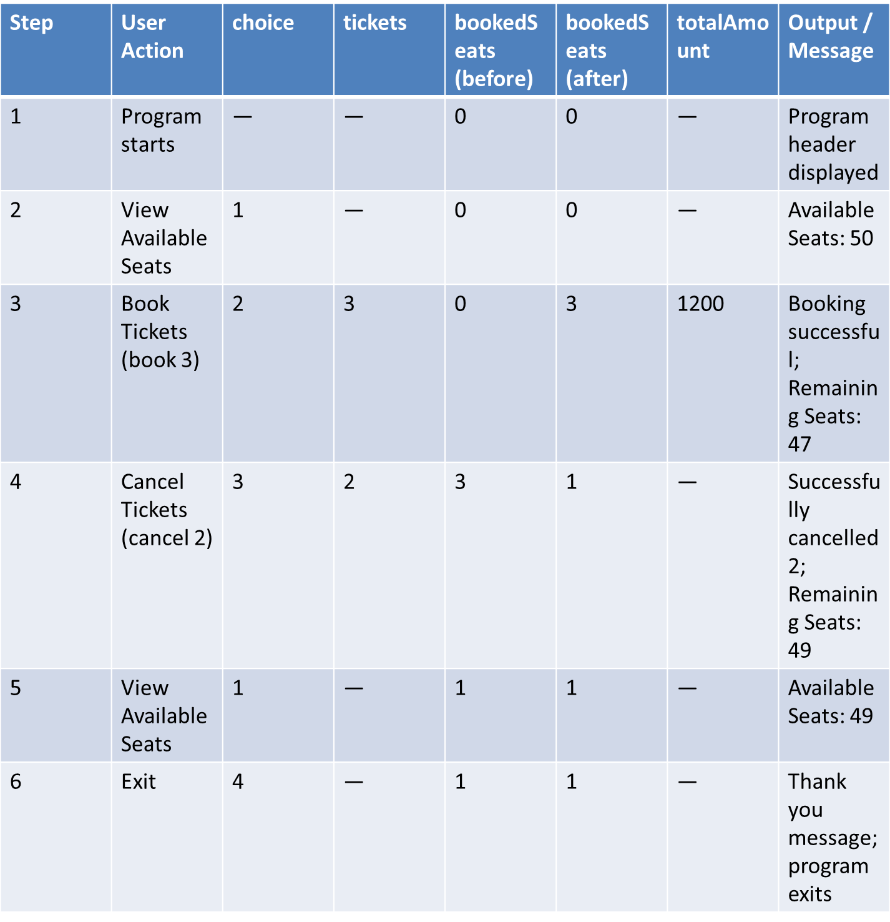
Dry Run Table
.

Slide 13

Thank You

